Slide 1
Bellabeat
Manufacture of health-focused smart products for women
July 13, 2022
Presented by Yunna Pudnik

Slide 2

Contents
Introduction
Data Points
Summary
Recommendations

Slide 3
Business task
Analyze smart device usage data in order to gain insight into how consumers use non-Bellabeat smart devices, find trends in smart devices usage and use these trends to influence Bellabeat marketing strategy.

Slide 4
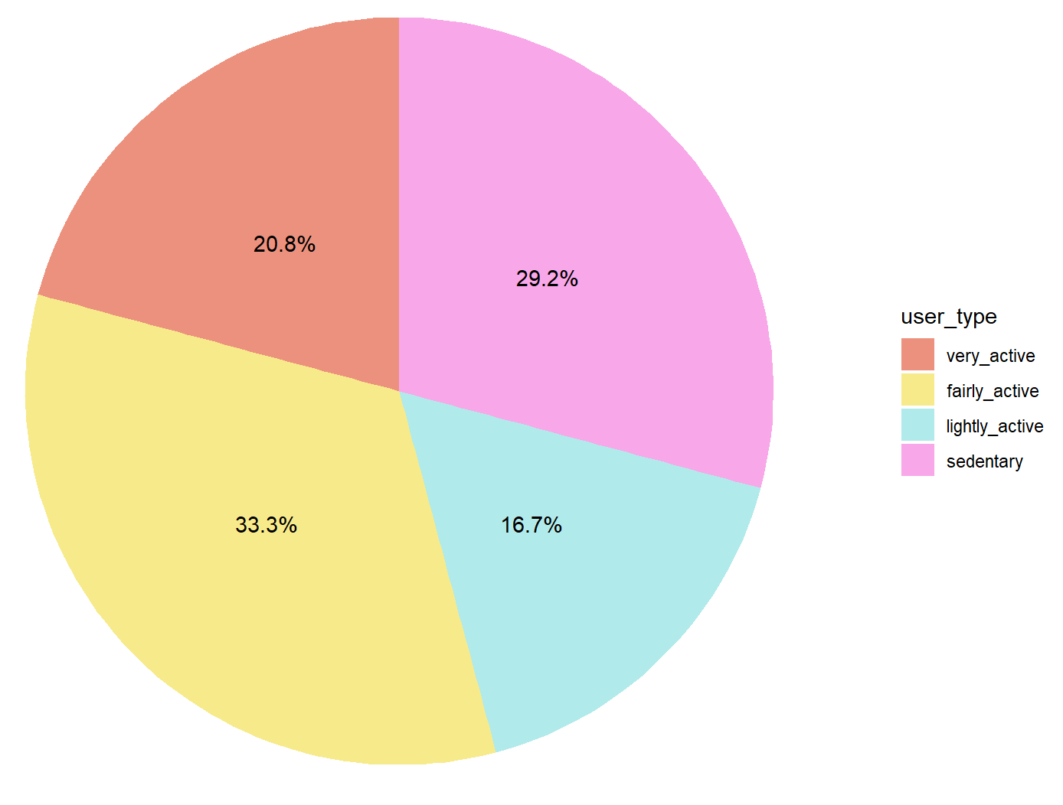
4 User Types
33% of participants we analyzed are fairly active, but the second biggest group is people who live sedentary lifestyle, which is more than 29%.

Slide 5
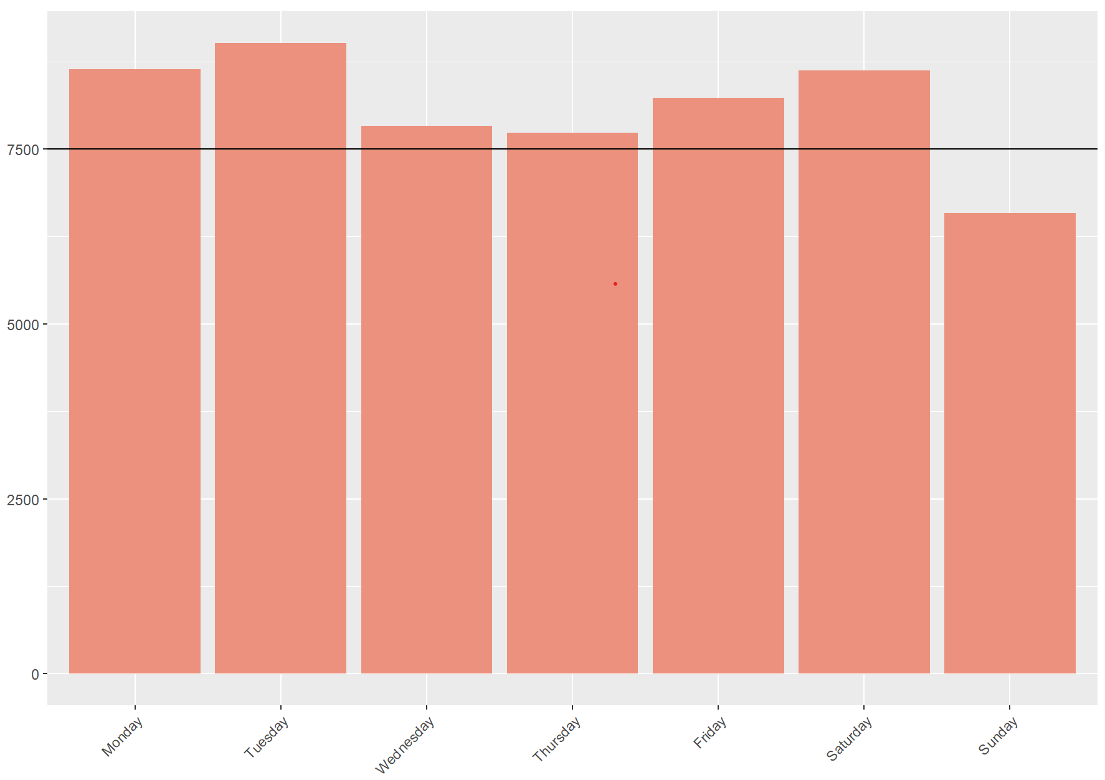
Number of Steps by Weekday
Participants cross minimum number of steps per day, unlike on Sunday, where the amount of steps is way below minimum.

Slide 6
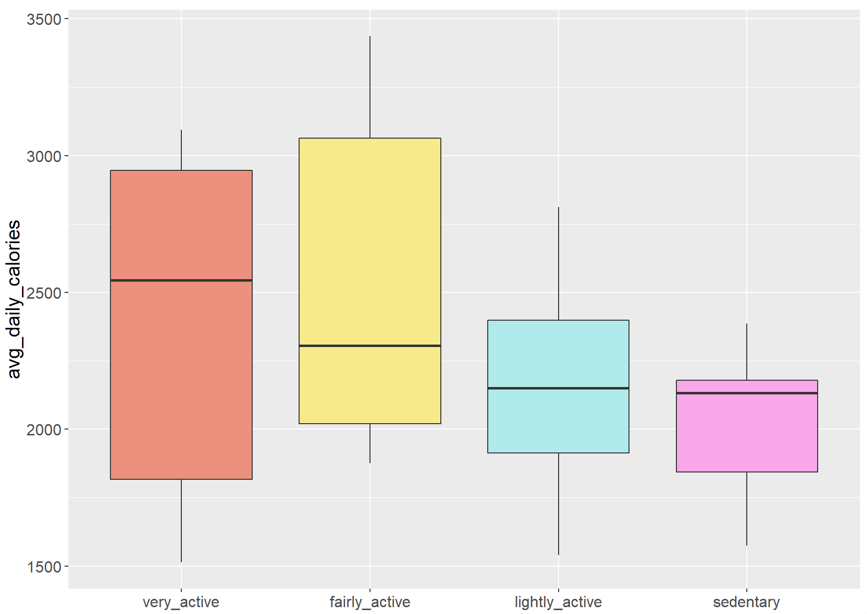
Calories Burnt by User Type
People with very active and fairly active lifestyle burn twice more calories than others.

Slide 7
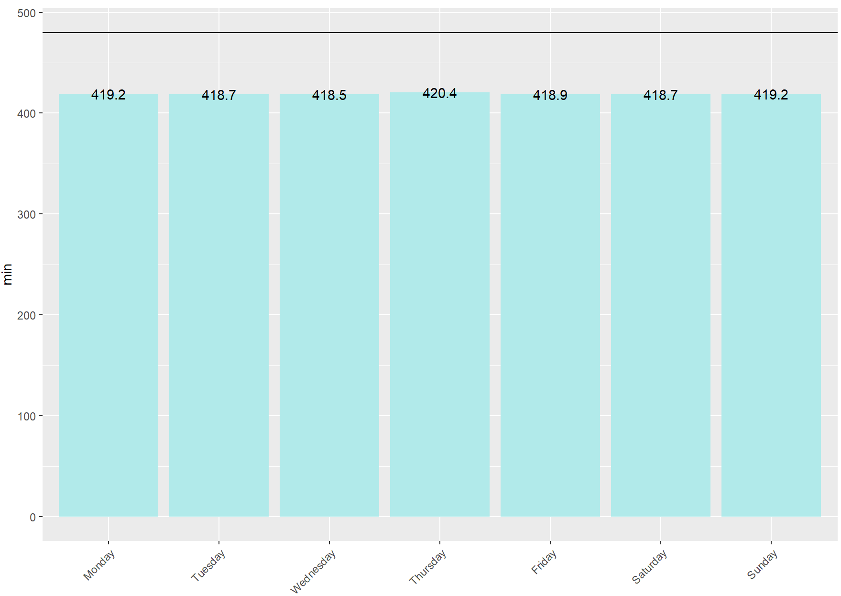
Time Asleep by Weekday
People sleep around 7 hours throughout a week, while the ideal number is 8 hours.

Slide 8
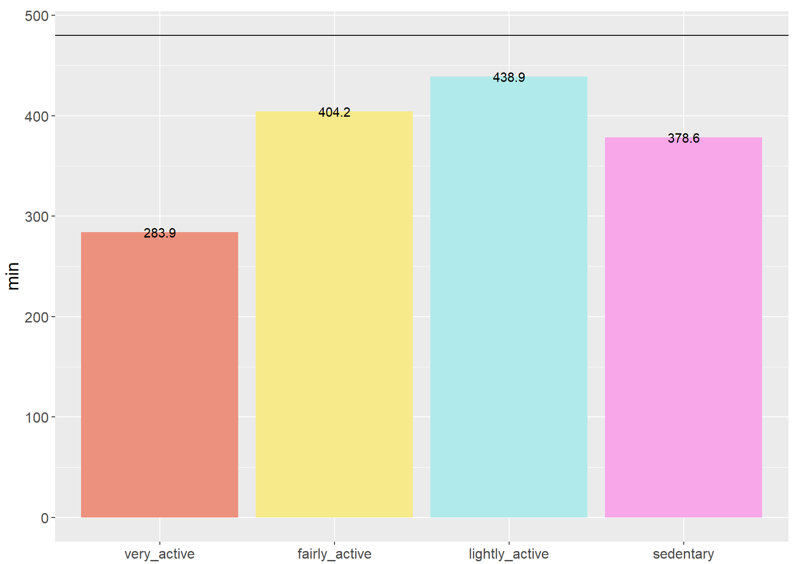
Time Asleep by User Type
Users do not sleep required 8 hours. People of very active type sleep around 5 hours on average.

Slide 9
Summary
Almost half of participants live either lightly active or sedentary lifestyle, but 33% are into very active lifestyle.
People tend to walk less on Sundays and barely touch minimum number of step throughout a week.
People with sedentary lifestyle burn the least calories.
Our participants sleep around 7 hours a night. And users of very active lifestyle sleep around 5 hours on average, which is 3 hours less than required amount.

Slide 10
Recommendations
Introduce benefits of regular 8 hours sleep to users. Develop short pre-sleep meditations. Also, offer people to set their sleep time alarm, so they can handle rest time better.
Create and promote weekend activities (e.g. Yoga class, Cardio trainings, and etc), in order to keep users active on Sundays.
Explain how 10.000 step a day can positively influence user’s health and offer a place for a walk nearby.
Promote psychotherapy for users with sleep issues.
Make discounts bonuses available for the most active users, to encourage them keep going.
Next step:
Create a survey for people with sedentary lifestyle and lightly active lifestyle to find out reasons and engage them accordingly.

Slide 11
THANK YOU!
Yunna Pudnik

